Slide 1
Effective Classroom Interaction
Patterns-A Diagrammatic Approach
Presented by –
Mr.K.K.Biswal
Associate Professor
22/08/2018

Slide 2
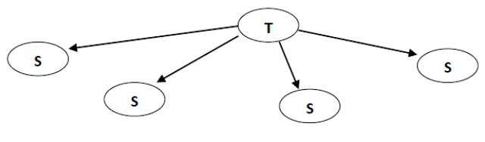
O2. Different types of interaction patterns in the 21st century classrooms
1. Effective classroom:

Slide 3
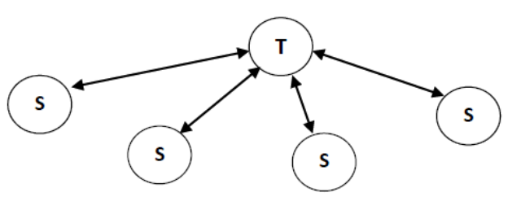
2. More Effective classroom:

Slide 4
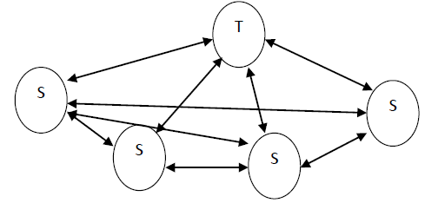
3. Most Effective classroom:

